Slide 1

Presentation Title
Carlito-Rey and Joshua

Slide 2



Agenda
Introduction – (what is this all about)
Getting Started – (what research did you do)
Interview Description – (who was the user, what are their needs)
Selection – (explain a few considerations)
Justification – (why does this fit the users needs)

Slide 3
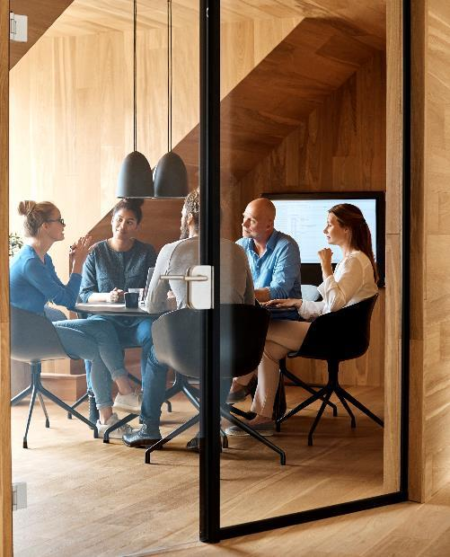



Introduction
A computer is an electronic device, operating under the control of instructions stored in its own memory that can accept data process the data according to specified rules, produce information and store the information for future use.

Slide 4

Getting Started
If you're serious about gaming, select a gaming PC with a powerful CPU processor and video graphics card. Don't neglect cooling, as gaming uses a lot of power. If you're buying a gaming laptop, see whether it has built-in heatsinks for additional cooling and consider a laptop cooling pad.

Slide 5
Interview Description
The video game industry encompasses the development, marketing, and monetization of video games. The industry encompasses dozens of job disciplines and thousands of jobs worldwide.

Slide 6
Selection
Choose a case that's compatible with your gaming environment and visual preferences. Prioritize choosing the right CPU and GPU, especially if you plan to play at higher resolutions or FPS. Consider an SSD for faster loading times. Make sure the system has plenty of accessible USB ports for connecting gaming devices.

Slide 7
Choses
Alienware Aurora Ryzen $1000 Dell
MSI Aegis RS $3029 Amazon
HP Omen 25L $800 Best Buy
MSI Infinite RS $4399 Amazon

Slide 8
Justification
The PC that my Peer Pieter chose was the Alienware Aurora Ryzen because it is more in his price range. It was also rated the best gaming PC of the year.

Slide 9

Summary

Slide 10


Thank You
Presenter name
Email address
Website address

Slide 11




Team
Name
Name
Name
Name
Title
Title
Title
Title

Slide 12
Chart

Slide 13
Table
 | Category 1 | Category 2 | Category 3 | Category 4
Item 1 | 4.5 | 2.3 | 1.7 | 5
Item 2 | 3.2 | 5.1 | 4.4 | 3
Item 3 | 2.1 | 1.7 | 2.5 | 2.8
Item 4 | 4.5 | 2.2 | 1.7 | 7

Slide 14

The way to get started is to quit talking and begin doing.
Walt Disney

Slide 15
Timeline
Title
To start a presentation, go to the Slide Show tab, and select From Beginning.
Title
To display Presenter view, in Slide Show view, on the control bar at the bottom left select the three dots, and then Show Presenter View.
Title
During your presentation, the speaker notes are visible on your monitor, but aren't visible to the audience.
Title
Title
If you don’t see the Notes pane or it is completely minimized, click Notes on the task bar across the bottom of the PowerPoint window.
The Notes pane is a box that appears below each slide. Tap it to add notes.

Slide 16
Content
Subtitle
Subtitle
Add text, images, art, and videos.
Add transitions, animations, and motion.
Save to OneDrive, to get to your presentations from your computer, tablet, or phone.
Open the Design Ideas pane for instant slide makeovers.
When we have design ideas, we’ll show them to you right there.

Slide 17
Content 2
Subtitle
subtitle
subtitle
Add text, images, art, and videos.
Add transitions, animations, and motion.
Save to OneDrive, to get to your presentations from your computer, tablet, or phone.
Open the Design Ideas pane for instant slide makeovers.
When we have design ideas, we’ll show them to you right there.
Add text, images, art, and videos.
Add transitions, animations, and motion.
Save to OneDrive, to get to your presentations from your computer, tablet, or phone.
Open the Design Ideas pane for instant slide makeovers.
When we have design ideas, we’ll show them to you right there.
Add text, images, art, and videos.
Add transitions, animations, and motion.
Save to OneDrive, to get to your presentations from your computer, tablet, or phone.
Open the Design Ideas pane for instant slide makeovers.
When we have design ideas, we’ll show them to you right there.

